Slide 1

Bancaja:
Developing Customer Intelligence
Group 10
Abdulaziz Alajaji, Fangling Zhang, Kavin Chandrasekaran, Sishi Hao

Slide 2
Agenda
Introduction
Conjoint Analysis Overview
Designing the Market Campaign
Mini-Campaigns Approach
Test market

Slide 3
The origins data back to 1978 when the Royal Economic Society of Friends of the Country of Valencia founded the parent company
Merge five Valencian savings banks to become commonly known as Bancaja
Merge with 6 regional savings banks to form Bankia Group
1878
1940
1991
1996
2010
First expansion
The largest financial institution in Valencia and the third largest savings bank in Spain; serve 3 million customers over 1,130 branches

Slide 4
Strategic Vision
The unity of the financial group
Cost-efficiency
The segment of commercial actions
Define the business vision of each new unit
Identify how it complemented larger organizational goals
Develop an internal organization system that would help consolidate the reinforce the group’s vision
Pressure to control in costs
Develop business objectives and action plans in every segment

Slide 5
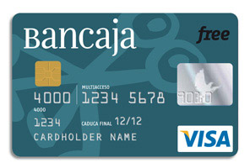
The Drive to Create BI
Want to exploit customer information to increase commercial effectiveness
Push for innovation in the nation Spanish credit market
To avoid considerable investment of time and money
Explore the potential benefits of CRM with a smaller pilot project

Slide 6
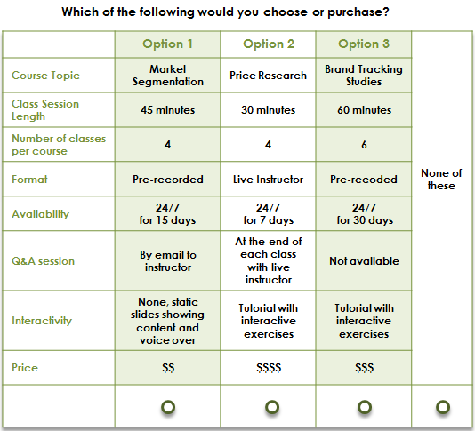
Conjoint Analysis:
Collect preferences for different attributes to design the product from potential or existing users.
Used in our school.

Slide 7

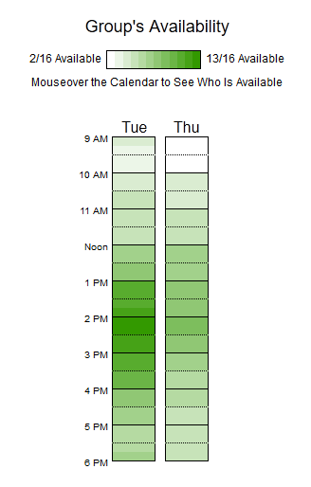

Slide 8
Conjoint Analysis
Two attribute tradeoff
Not feasible for large number of attributes.
Full Profile
Time consuming and resource intensive.
Adaptive Conjoint Analysis
Faster because of fewer attributes.
Choice based conjoint
Faster because fewer profiles.
Self-explicated
Fewer inputs and comparable performance to full profile
Hierarchical Bayes
Best when users cannot respond to all attribute level for creating attribute utility.
Notes:
Two attribute- rank all combination of level in attributes.
Full Profile - complete profile based on factorial design of attribute levels.
Adaptive - user eliminates uninterested attributes and levels followed by two att or full prof.
Choice - subsets of full profiles.
Self explicated - user picks attributes and score levels on fixed scale. Then attribute level utility formed based on weighted levels and importance of attributes.
Hierarchical Bayes - uses averages when attribute level utility is not found for a respondent or group.

Slide 9
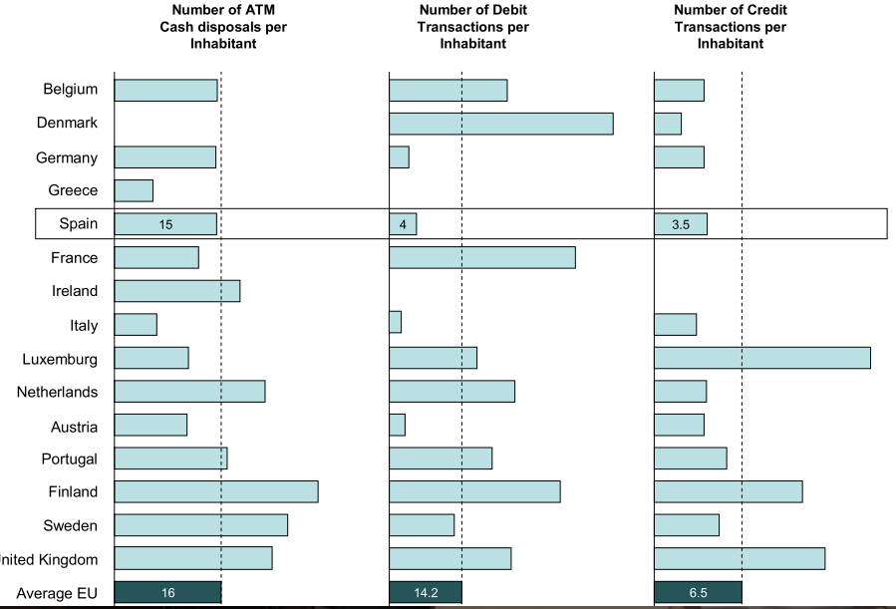
Credit card Project
Spain had below average credit card usage in Europe.
By improving the customer intelligence for credit cards, they would collect more data and better serve the customers by analyzing customer usage and make changes to improve the credit card usage.

Slide 10
Designing The Market Campaign
Based on the case study, there are 11 attributes for making a credit card, Examples:
Whether we will put Sign-up or Annual fees,
Less or More details in mailing brochure content
There are many attributes and many levels : If we consider all different combinations for 2 values of 11 attributes, then we would need 2^11 combinations.
Doing Traditional Conjoint Analysis considering all possible of attributes is not efficient way because it’s not tailored towards specific kind of customer segment.
Having mini campaigns and focusing on certain groups and use them as a feedback mechanism to make changes to future campaigns would be efficient

Slide 11
Choosing Attributes
In order to see what attributes are important we could market a set of different credit cards to different groups and see which combinations was the most successful.
Because we have many attributes and many levels under each attributes, we will chose subset of attributes and consider only two levels under each attribute to design our mini-campaigns:
Interest Rate
Credit Limit
Amount of Details in Mailing Brochure
The Insurance policy, Theft Protection
Gifts
Channel (of handing in PIN numbers, for customer to start using the card )

Slide 12
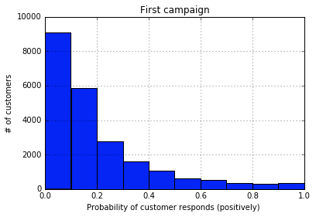
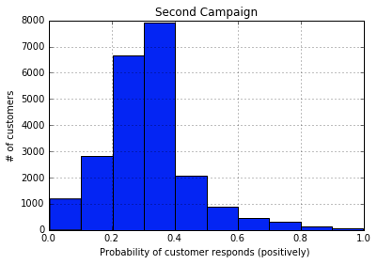
Using statistical methods, to measure campaign efficiency
Notes:
Assuming we could quantify how a customer react to a certain campaign

Slide 13
Perceptual measures vs Behavioral Measures
In the previous plot, we are using perceptual measures, this measures how likely a customer will purchase.
A more useful experiment would be involving behavioral measures (actions taken by customer ), which is directly linked to profit.
That’s why having a min-campaigns on real population of targeted customers would produce useful feedback for decision makers.
We should note this might be an expensive approach.
A Step-by-Step Guide to Smart Business Experiments Eric T. Anderson and Duncan Simester
THE MARCH 2011 ISSUE, Harvard Business Review

Slide 14
Combinations for the mini campaigns
Treat credit limit, interest rate and insurance as one attribute (1-high credit limit, high interest rate, include insurance; 0- low credit limit, low interest rate, no insurance)
Combination | credit limit | interest rate | The Insurance policy | channel | campaign gift | Mailing Brochure Content
1 | 0 | 0 | 0 | 0 | 0 | 0
2 | 0 | 0 | 0 | 0 | 0 | 1
3 | 0 | 0 | 0 | 1 | 1 | 0
4 | 0 | 0 | 0 | 1 | 1 | 1
5 | 1 | 1 | 1 | 0 | 0 | 0
6 | 1 | 1 | 1 | 0 | 0 | 1
7 | 1 | 1 | 1 | 1 | 1 | 0
8 | 1 | 1 | 1 | 1 | 1 | 1

Slide 15
Combinations for the mini campaigns
Treat credit limit, interest rate and insurance as one attribute (1-high credit limit, high interest rate, include insurance; 0- low credit limit, low interest rate, no insurance)
Combination | credit limit | interest rate | The Insurance policy | channel | campaign gift | Mailing Brochure Content
1 | 0 | 0 | 0 | 0 | 0 | 0
2 | 0 | 0 | 0 | 0 | 0 | 1
3 | 0 | 0 | 0 | 1 | 1 | 0
4 | 0 | 0 | 0 | 1 | 1 | 1
5 | 1 | 1 | 1 | 0 | 0 | 0
6 | 1 | 1 | 1 | 0 | 0 | 1
7 | 1 | 1 | 1 | 1 | 1 | 0
8 | 1 | 1 | 1 | 1 | 1 | 1

Slide 16
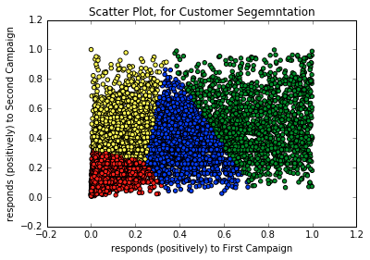
Other considerations for the test market
Number of Subjects: from cluster 4 (yellow points) and do not have hascard now.
The market should be localized geographically
red 8855 Yellow 8027 green 1696 blue 3925

Slide 17
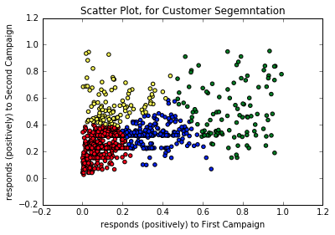
red 557 Yellow 110 green 109 blue 224

Slide 18
Selecting Test market
For each mini-campaign, first we want to make sure we select a market that is representative of a larger population.
Customer distinguishing characteristics we should consider for finding representative target groups?

Slide 19
Discussion Questions
Is the credit card project appropriate for launching customer intelligence at Bancaja? Why or why not? Other suggestions for customer intelligence?
Which attributes would you choose for designing your credit card campaign?
What are customer distinguishing characteristics we should consider for finding representative target groups?

